Slide 1



Python & SQL Portfolio
Stefanus Yudi Irwan – July, 24th 2022

Slide 2
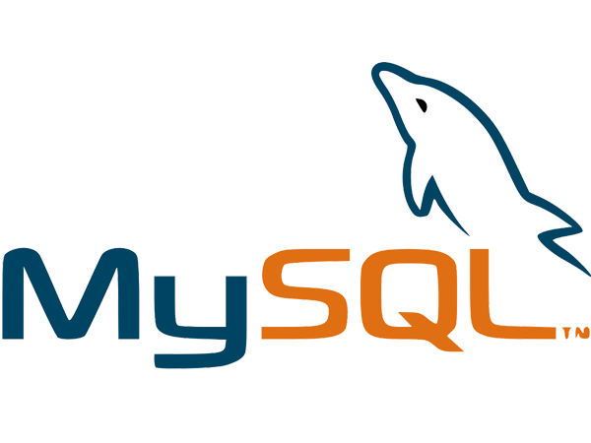

SAT Library Management System is an application for helping librarians manage the library. This app was designed using Python and MySQL.
Python & SQL Portfolio
1

Slide 3

OUTLINE
Goals
Application Menu
Project Steps
Source Code
Application Architecture
Python & SQL Portfolio
2

Slide 4

Goals

Slide 5

Project Goals
Goals
Project Steps
Application Architecture
Application Menu
Source Code
1.
Help Librarian manage library data through apps
Design database for managing and storing library data
Design GUI features to interact with the library database
2.
3.
Python & SQL Portfolio
4

Slide 6

Project Steps

Slide 7






Goals
Project Steps
Application Architecture
Application Menu
Source Code
Project Steps
EXECUTABLE
Create Executable File
DEBUGGING
Test, Correct, Update, and Enhance the Code Defense
INTERFACE
Create Graphical User Interface
CONNECTOR
Create Connector for Database to Python
DATABASE
Create Database Structure, Stored Function, and Procedure
REQUIREMENT
Define Apps Requirement
Python & SQL Portfolio
6

Slide 8

Application Architecture

Slide 9






Building Block
Goals
Project Steps
Application Architecture
Application Menu
Source Code
Object Menu Frame
Functions
Defense Programming Feature
Channel
Communication
MySQL Connector
User Data Table
Book Data Table
Transaction Data Table
Stored Functions
Stored Procedures
Python & SQL Portfolio
8

Slide 10

Application Menu

Slide 11
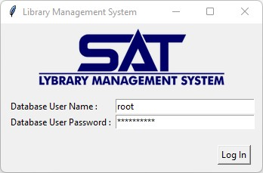
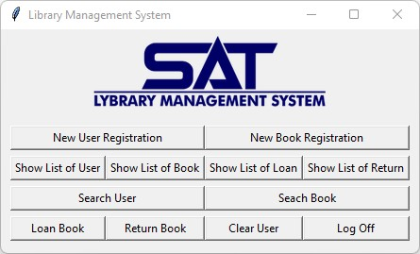
Menu
Goals
Project Steps
Application Architecture
Application Menu
Source Code
Login Page
Require local database username and password
Main Page
Contain all menus for the application
Python & SQL Final Project
10

Slide 12
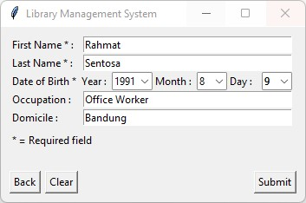
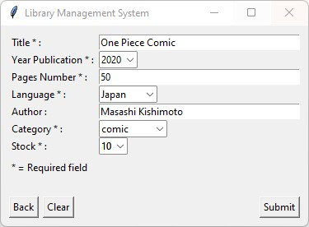
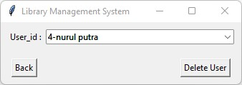
Menu
Goals
Project Steps
Application Architecture
Application Menu
Source Code
New User Registration
Input data for library new member
New Book Registration
Input data for library new book
Clear Member
Clear a member from the library
Python & SQL Portfolio
11

Slide 13
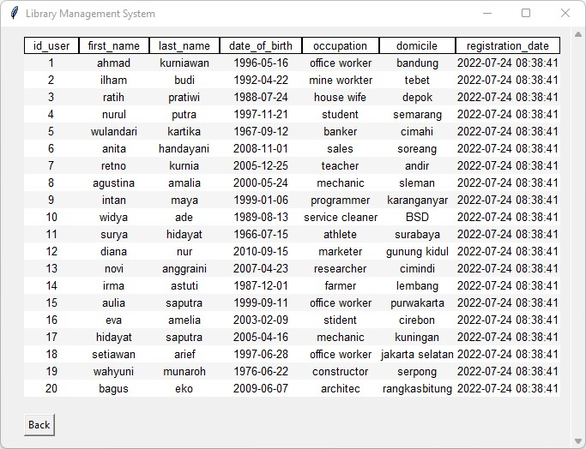
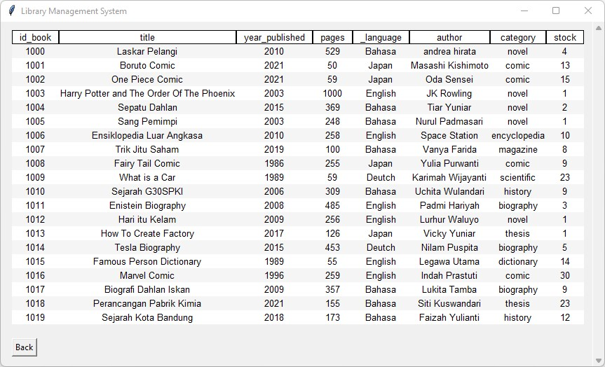
Menu
Goals
Project Steps
Application Architecture
Application Menu
Source Code
Show Member List
Show member data : member id, name, birth, occupation, domicile, and registration date
Show Book List
Show book data : book id, title, year published, pages, language, author, category, and stock inside the library
Python & SQL Portfolio
12

Slide 14
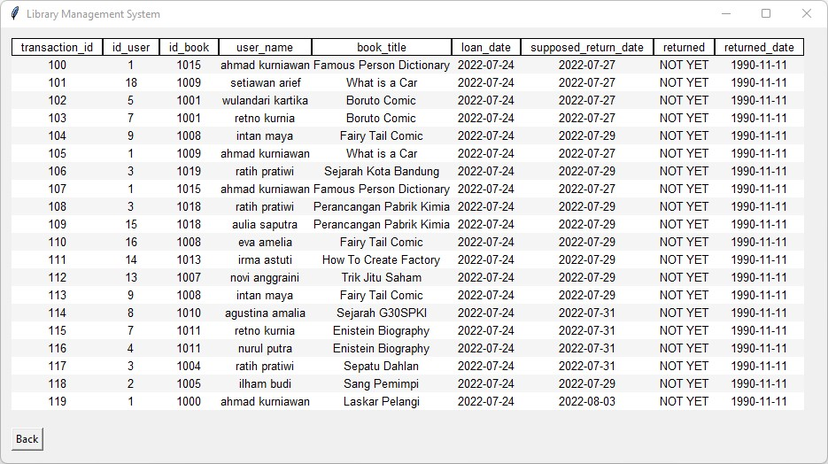
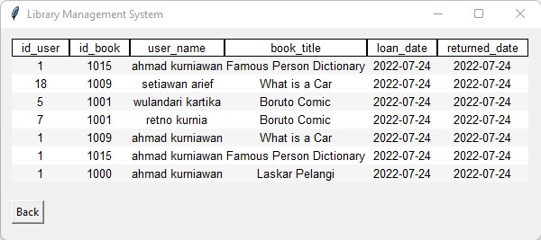
Menu
Goals
Project Steps
Application Architecture
Application Menu
Source Code
Show Loan List
Shows book loan data : transaction id, id user, id book, user name, book title, loan date, supposed return date, and return status
Show Return List
Shows book return data : user id, id book, user name, book title, loan date, and returned date
Python & SQL Portfolio
13

Slide 15
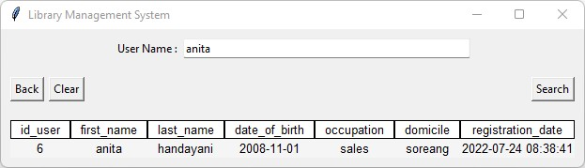
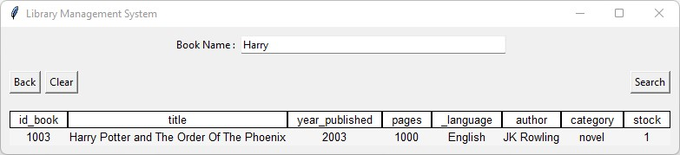
Menu
Goals
Project Steps
Application Architecture
Application Menu
Source Code
Search User by Name
Input user name, then shows the user data saved in database
Search Book by Title
Input book title, then shows the book data saved in database
Python & SQL Portfolio
14

Slide 16
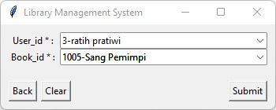
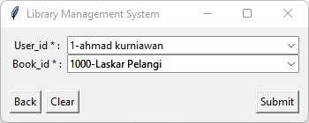
Menu
Goals
Project Steps
Application Architecture
Application Menu
Source Code
Loan Book
Input data to loan books from the library
Return Book
Input data to return books back to the library
Python & SQL Portfolio
15

Slide 17
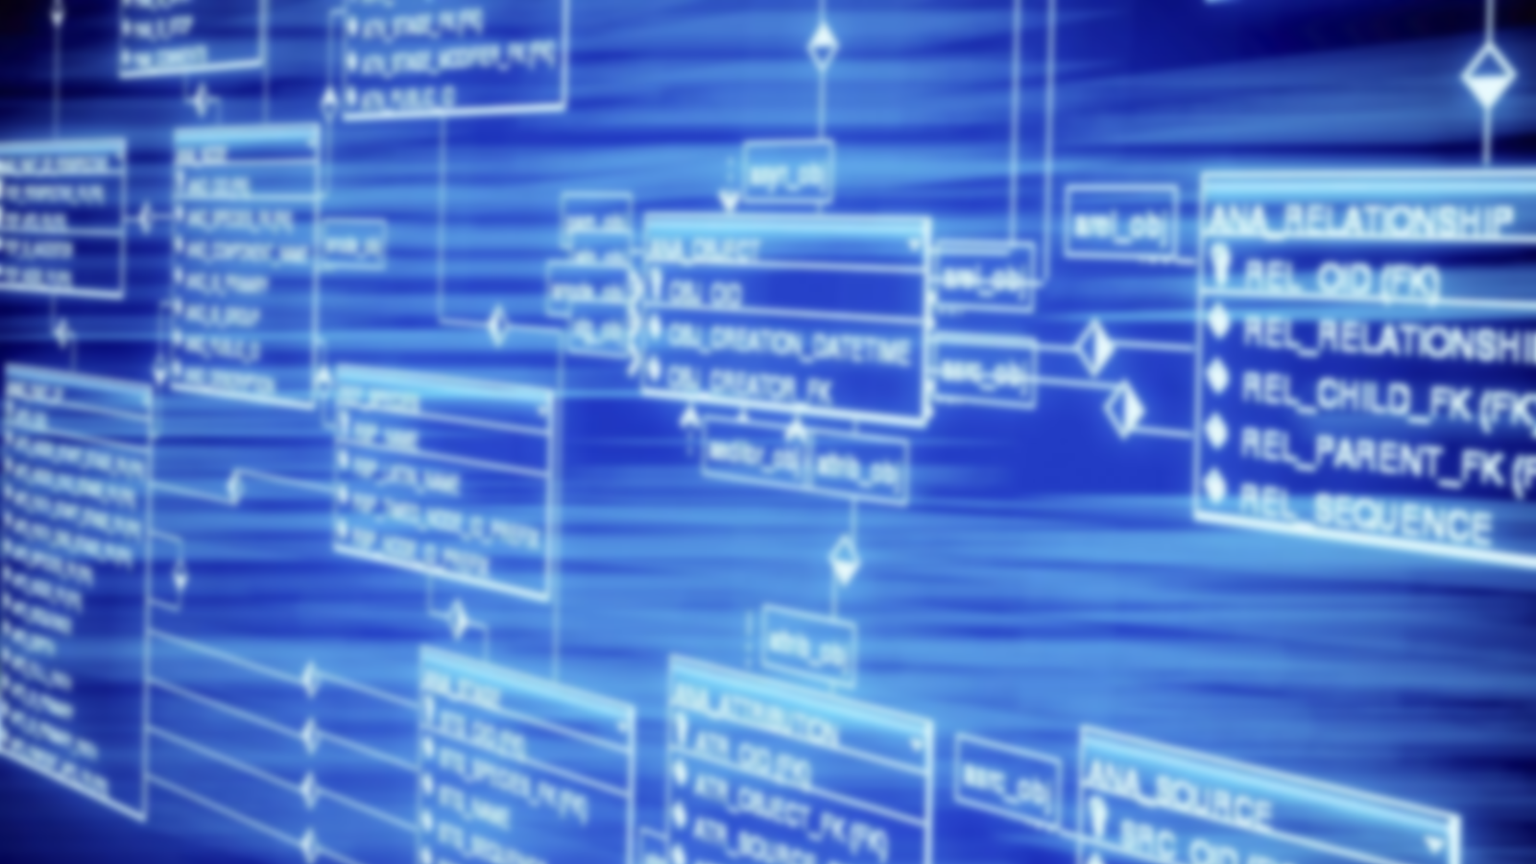
Source
Code

Slide 18

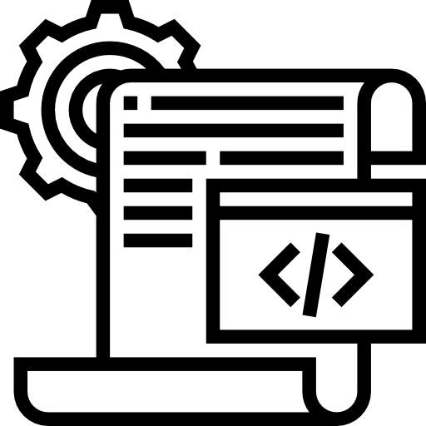
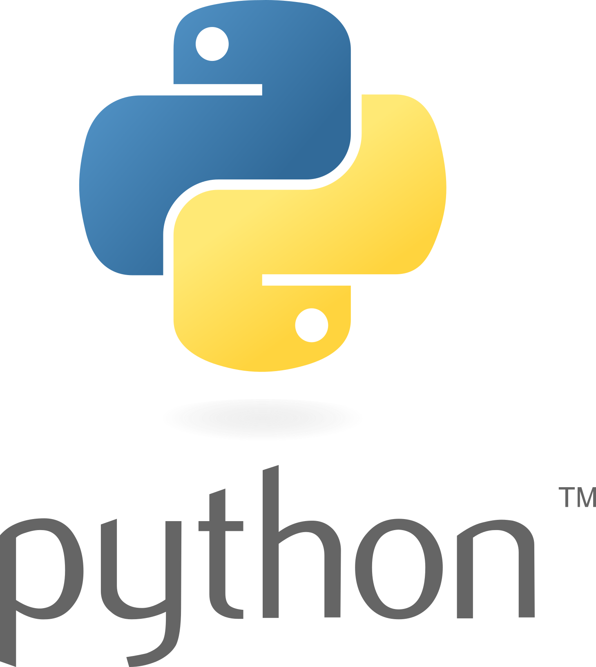
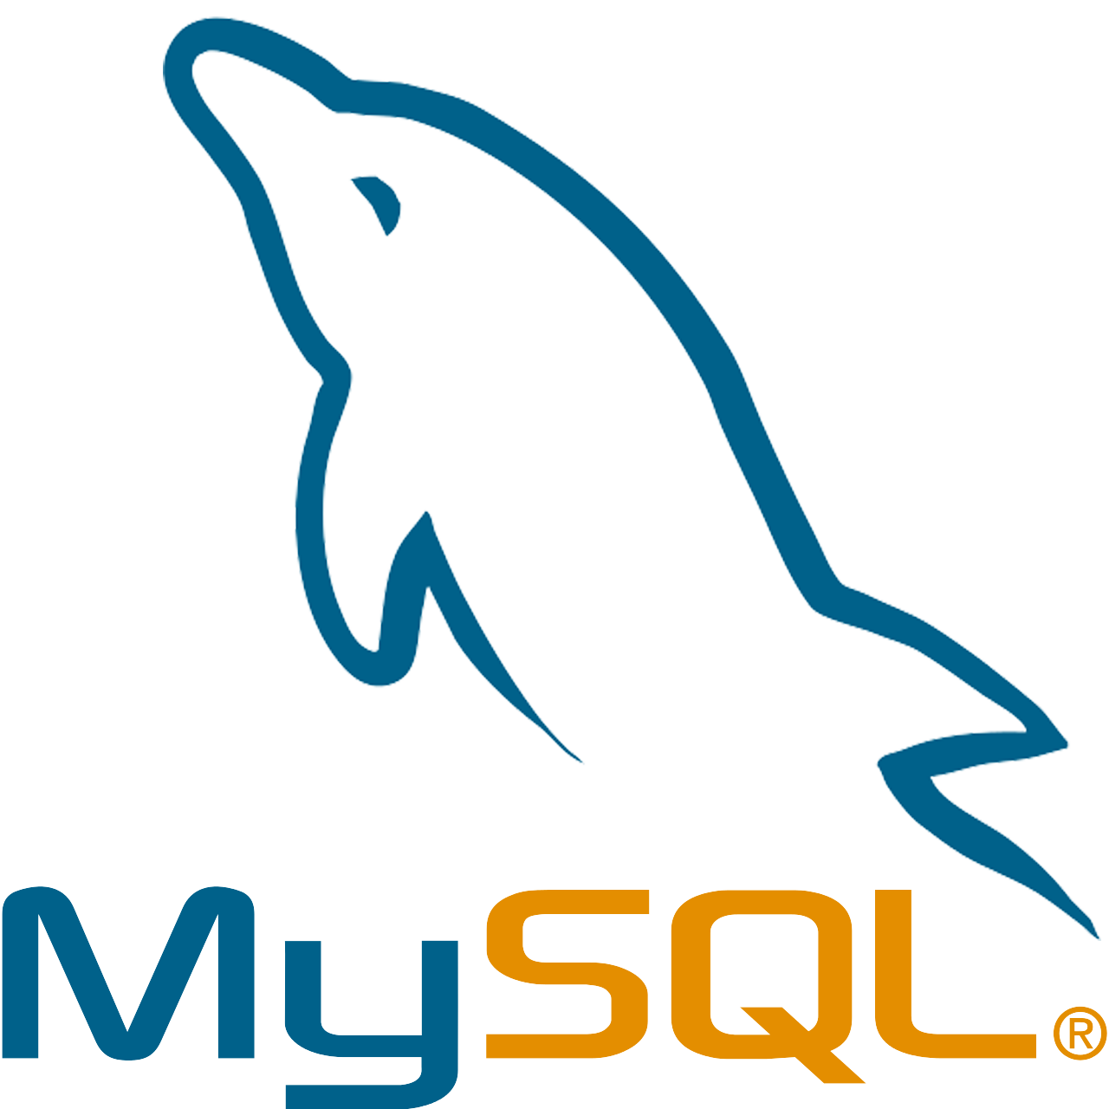
Source Code
Goals
Project Steps
Application Architecture
Application Menu
Source Code
https://github.com/StefanusYudi22/Library-Management-System
Important Files
lib-management-gui-app.py
connect_mysql.py
library-management-db.sql
Python & SQL Portfolio
17

Slide 19


Slide 20
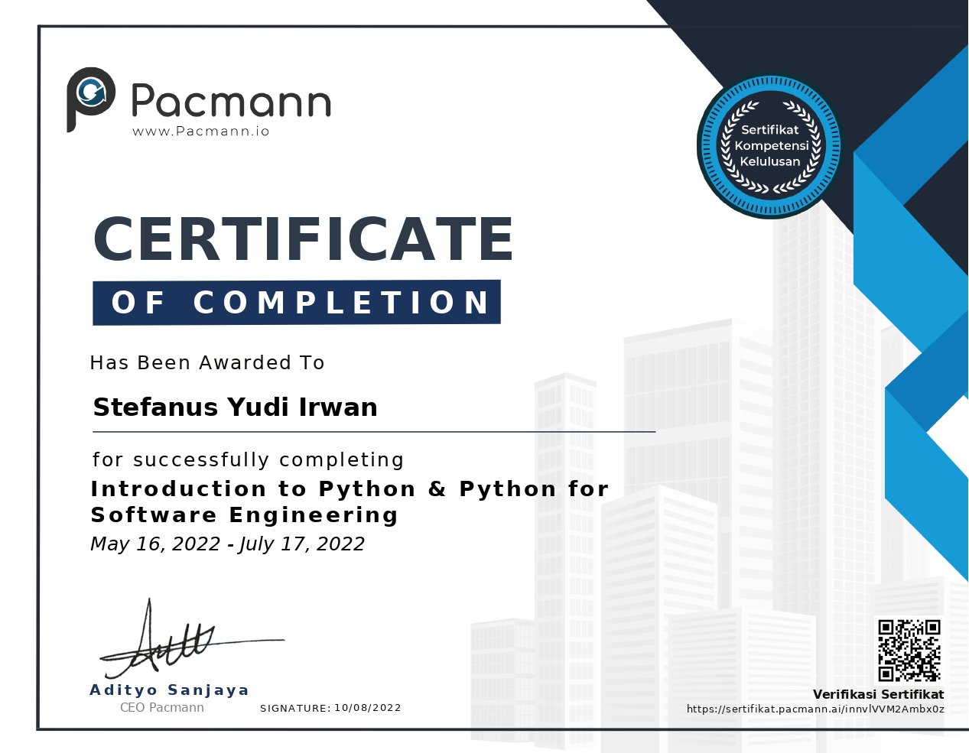

Slide 21


Slide 22


Reach me for further discussion
yudi.stefanus22@gmail.com
https://www.linkedin.com/in/stefanusyudi22
Python & SQL Portfolio
18

